Slide 1
Bring your existing code to the Universal Windows Platform on Windows 10

Slide 2
Bringing your code to Windows 10
Expanding middleware partnerships
Extending your investments on the web
Bridges for Windows and other mobile platforms
Notes:
To recap:
We’re continuously expanding partnerships with top middleware providers to ensure you can continue to use your current ecosystem of tools
With our out-of-the-box support for Apache Cordova in Visual Studio 2015 and mechanisms to create web apps that can natively access Windows features, you can extend your investments on the web to Windows 10
Finally, a number of bridging technologies and porting guidance is being created by Microsoft, partners and the community to accelerate the adoption of the Universal Windows Platform

Slide 3
Journey to Windows 10
One Core OS
One App Platform
Windows Desktop
Windows Phone
Xbox
One Store
One Store
Internet of things
HoloLens
Surface Hub
Notes:
It has been a real journey for us to get to one Windows with Windows 10. Over time we have merged the different operating systems and devices into one, starting by merging the lower level parts of the OS, then the developer experience, and now with Windows 10, we have unified all of the Windows family.
At the same time, we have been able to quickly add several new device families to Windows. This has been a multiyear journey and with Windows 10 we now have one core operating system, one app platform, and one Store to empower developers to reach their Windows customers wherever they are and on whatever device they happen to be using.

Slide 4
Journey to the Universal Windows Platform
Mobilize.Net’s
Silverlight Bridge
(Porting)
Guidance
Windows Phone
Desktop Bridge
Hosted Web Apps
Other platforms
iOS Bridge
Desktop
Web
iOS
Notes:
We recognize that you have code on various platforms that you may want to use as a starting point to bring your own apps to the Universal Windows Platform. As mentioned, we are committed to help accelerate that work through porting guidance, tooling (bridges) and added capabilities in the Universal Windows Platform.

Slide 5
Bringing your code to Windows 10
Wherever your code was born, you can bring it to Windows 10
New opportunities
Expand to reach PC, Xbox One, and Mobile
Emerging form-factors (IoT, Holographic)
Reach Windows 10 faster
Bridges accelerate time to Windows
Support for middleware + game engines
Go native at your pace
‘Light up’ Windows differentiators
Get more use out of your core code
Windows platform
Universal Windows 8.x apps
Windows Phone Silverlight apps
Existing desktop applications
Other platforms
iOS apps
Android apps
Others
Middleware platforms
Middleware (e.g., Xamarin)
Game engines (e.g., Unity)
App middleware
Web platform
Web apps
Packaged web apps
Hosted web apps
Notes:
Wherever your code was born, we want to help accelerate in bringing it to Windows and the Universal Windows Platform. To do so, we have several approaches:
Porting guidance for platforms like Universal Windows 8.x apps, Windows Phone Silverlight apps, Android and iOS apps for when you want to natively bring your app to UWP, taking advantage of everything it has to offer from language to tooling. We’re continuously updating and expanding this porting guidance to enable accelerated adoption of UWP
Partnerships with middleware providers across frameworks, game engines and app middleware to ensure you can keep using what you have already invested in.
Helping you extend your investments on the web by providing support for packaged web apps with Apache Cordova, first-class browser support with Microsoft Edge and the creation of Hosted Web Apps, which enables you to call native UWP functionality directly from your hosted website’s JavaScript through a UWP app that encapsulates your website and makes it available in the Windows Store
And finally a set of technologies that Microsoft and partners are working on, collectively dubbed “bridges”, that can help accelerate bringing existing code to Windows. The Windows Bridge for iOS is one of the bridges Microsoft is developing, which enables bringing Objective-C code to the Universal Windows Platform, powered by Visual Studio as the IDE (demo in a few minutes). Another example is a bridge for Windows Phone Silverlight apps by our partner Mobilize.Net, that provides a number of platform mappings and translations to do the heavy lifting in bringing your Windows Phone Silverlight app to UWP

Slide 6
Middleware platforms
Wherever your code was born, you can bring it to Windows 10
Middleware platforms
Middleware (e.g., Xamarin)
Game engines (e.g., Unity)
App middleware
Windows platform
Universal Windows 8.x apps
Windows Phone Silverlight apps
Existing desktop applications
Web platform
Web apps
Hybrid web apps (Cordova)
Hosted web apps
Other mobile platforms
Android apps and iOS apps
Notes:
Some of you may already be building apps across different platforms, so let’s start by talking about middleware platforms.

Slide 7















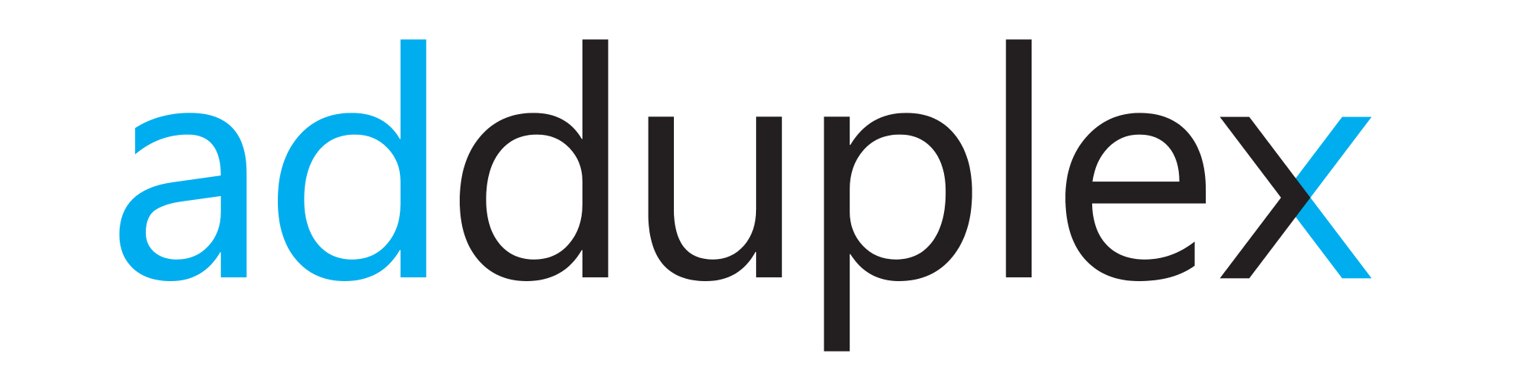
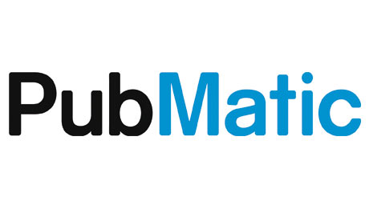
App Middleware for UWP apps
Middleware partnerships that help with development, analysis, user acquisition, and monetization
Development
Analysis
User acquisition
Monetization
Middleware that helps develop apps takes advantage of solutions that allow a common code base to be used across platforms as well as tools to help with A/B testing, crash reporting, etc. Leading providers such as Unity, Cocos2d, Marmalade, Xamarin, Hockeyapp, Crittercism, Bugsense support apps built for Windows.
Visual Studio Application Insights and Mobile Engagement
Analysis of user usage and behavior with apps enables developers to optimize for usability, customer satisfaction and monetization. Microsoft’s App Insights, Adobe Analytics, and Localytics provide solutions for Windows app.
User acquisition puts the ability to promote and gain users in the hands of the developers. Many different strategies can be employed such as improving attribution, retargeting, or programmatic marketing. Kochava, Apsalar, Urban Airship, App Boy offer services to drive user acquisition.
Monetization of apps is a key aspect of a viable ecosystem. Monetization can be through direct payment using the Microsoft Store commerce capabilities for charging per download or for in app purchases. Additionally, advertising offers monetization opportunities and Microsoft Ads, Smaato, Inneractive, and AdDuplex offer solutions for Windows apps.
Notes:
Main areas of middleware use in apps include products that help with development, analysis, user acquisition, and monetization.
Middleware that helps develop apps takes advantage of solutions that allow a common code base to be used across platforms as well as tools to help with A/B testing, crash reporting, etc. Leading providers such as Unity, Cocos2d-x, Marmalade, Wave Engeine, HockeyApp, Crittercism, BugSense support apps built on UWP
Analysis of usage and behavior with apps enables developers to optimize for usability, customer satisfaction and monetization. Visual Studio Application Insights and Mobile Engagement, Adobe Analytics, and Localytics provide solutions for UWP apps
User acquisition puts the ability to promote and gain users in the hands of the developers. Many different strategies can be employed such as improving attribution, retargeting, or programmatic marketing. Facebook, Vungle, Kochava, Urban Airship offer services to drive user acquisition
Monetization of apps is a key aspect of a viable ecosystem. Monetization can be through direct payment using the Microsoft Store commerce capabilities for charging per download or for in app purchases. Additionally, advertising offers monetization opportunities and Microsoft Ads, Smaato, Inneractive, Pubmatic, and AdDuplex offer solutions for Windows apps.

Slide 8
Windows platform
Wherever your code was born, you can bring it to Windows
Middleware platforms
Middleware (e.g., Xamarin)
Game engines (e.g., Unity)
App middleware
Windows platform
Universal Windows 8.x apps
Windows Phone Silverlight apps
Existing desktop applications
Web platform
Web apps
Hybrid web apps (Cordova)
Hosted web apps
Other mobile platforms
Android apps and iOS apps
Notes:
Let’s continue with the existing apps and applications on Windows, spanning Windows 8.x apps, Windows Phone Silverlight apps and existing desktop applications.

Slide 9
Windows Phone Silverlight apps
Bringing your Windows Phone Silverlight apps to the Universal Windows Platform on Windows 10
Mobilize.Net’s Silverlight bridge
Free third party bridge
Conversion of C# code and XAML
Project manifest conversion
2300 mappings for top APIs and components
Extensibility
All mappings open sourced on GitHub
Documentation on GitHub Wiki
Developers can create mappings and submit a pull request to share with others
Mobilize.Net’s Silverlight bridge
Convert
Notes:
In a partnership with Microsoft, Mobilize.Net has created a Silverlight bridge, that will enable developers to accelerate bringing their existing Windows Phone 8.1 Silverlight code to the universal Windows Platform on Windows 10. This is done by converting the existing package manifest, C# code and XAML to the equivalents on UWP.
The bridge, released in December, has 2300 platform mappings available, which aims to do the heavy lifting for 80% of the code and XAML of the top 80% of apps.
These mappings are all open sourced on GitHub, available for community contributions and forking. In addition to the documentation also being available on GitHub, developers can create their own platform mappings and submit it to the project via a pull request.

Slide 10
Demo
Windows Phone Silverlight apps to UWP apps with Mobilize.Net’s Silverlight bridge

Slide 11
Existing desktop apps
Bringing your existing desktop apps to the Universal Windows Platform
UWP apps using desktop extensions
Support for existing .NET (WinForms/WPF) + Win32 apps
Desktop App Converter converts apps to the Universal Windows installer and deployment technology
Easier distribution + migration
Access UWP APIs within your app instantly to use Live Tiles, notifications, Cortana, and more
Choose the path forward that makes sense for your app:
Enhance your app (e.g. access UWP APIs)
Add a UWP process to the app package (e.g. add XAML UI, app services, etc.)
.msi
.appx
Notes:
Previously announced as Project ‘Centennial’ and now an integral part of Windows 10 and the Universal Windows Platform, is Microsoft’s bridge for existing desktop apps, like Win32 and .NET
With the Desktop App Converter, package your existing desktop apps the same way as a UWP app, giving the you and the user the benefit of the streamlined (un)installation process while still delivering the full use of your existing app your users are familiar with. This is essentially a different installer technology which abstracts the app’s initial file system and registry operations so that installation and removal is an entirely discrete process and the app cannot make persistent changes to these systems during installation
Additionally, the app is given an app identity after the conversion process, which is the key to accessing many of the newer UWP APIs, allowing your existing desktop application to make use of all of the new differentiated features such as Live Tiles, notifications, Cortana, and more
This opens up the opportunity to either enhance your app with UWP APIs directly from your existing code or adding a UWP process to the app package, which can be used to migrate the app, add XAML UI, app services and more.
Note that existing desktop apps converted this way can only run on systems on which they ran before (that is, they remain bound to desktop) until they are migrated to stop using the desktop extensions

Slide 12
Existing desktop apps
Bringing your existing desktop apps to the Universal Windows Platform
Universal Windows Package
Universal Windows Package
Universal Windows Package
Universal Windows Package
Universal Windows Package
Desktop app
Desktop app
Desktop app
Desktop app
UWP app
UWP APIs
UWP app
UWP app
Convert
Enhance
Extend
Migrate
Expand
Convert your app to improve the user’s installation and uninstallation process, while keeping the PC clean
Enhance and extend the app to light up new Windows 10 features, while migrating over time
Finally, expand to all Windows 10 devices like PC, Xbox One and Hololens
Convert your app to improve the user’s installation and uninstallation process, while keeping the PC clean
Enhance and extend the app to light up new Windows 10 features, while migrating over time
Finally, expand to all Windows 10 devices like phones, Xbox One and Hololens
Notes:
The bridge is a way for you to choose the pace at which you want to bring your existing desktop app to the Universal Windows Platform and to what capacity.
At a minimum, conversion of the app to a Universal Windows package will improve the user experience regarding installation and updating
Once converted, you can enhance the existing codebase with calls to new UWP APIs such as Live Tiles, push notifications or local/roaming app data
By adding a UWP app process to the same app package, you can extend the app with things like App Services, background tasks or even XAML UI
Over time, you can migrate more of your code to the UWP app process portion of the package, moving closer to having a true ubiquitous UWP app
Finally, after all the code is moved to the UWP app process, the desktop app is no longer needed and the app’s target can be expanded to phones, Xbox One, IoT devices and HoloLens

Slide 13
Demo
Existing desktop apps to the Universal Windows Platform

Slide 14
Web platform
Wherever your code was born, you can bring it to Windows
Middleware platforms
Middleware (e.g., Xamarin)
Game engines (e.g., Unity)
App middleware
Windows platform
Universal Windows 8.x apps
Windows Phone Silverlight apps
Existing desktop applications
Web platform
Web apps
Hybrid web apps (Cordova)
Hosted web apps
Other mobile platforms
Android apps and iOS apps
Notes:
Moving on to your existing investments on the web, this can be either web technologies with HTML/JavaScript/CSS running on the device (Cordova, PhoneGap, etc.) or web sites that already offer a great adaptive experience and want to access platform capabilities.

Slide 15
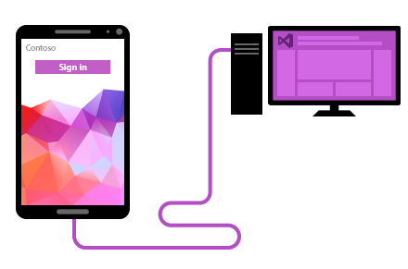
Packaged web apps
Build apps for Windows, iOS and Android using web technologies and Visual Studio
Visual Studio Tools for Apache Cordova
Single install
Code creation in Visual Studio
Preview and test on iOS, Android and Windows
Debugging support in Visual Studio
Access native device capabilities
Use Cordova plugins within your solution to access native device capabilities
Notes:
With a nudge to the previous topic, middleware, we can start off by talking about the Visual Studio Tools for Apache Cordova.
Apache Cordova is open-source technology that enables developers to write HTML, JavaScript and CSS, which gets wrapped in a native app wrapper. The web code is displayed in a WebView on the various platforms, but the interesting part is that Apache Cordova provides cross-platform JavaScript libraries to access native device capabilities. For example, accessing the device’s gyroscope can be done using a uniform JavaScript call, thanks to Apache Cordova’s libraries.
What the Visual Studio Tools for Apache Cordova does, is streamline the installation process of Apache Cordova, enable the use of Visual Studio for coding, testing and debugging and accelerate the use of cloud services in your app. If you already use Apache Cordova as middleware for your existing cross-platform development, the Visual Studio Tools for Apache Cordova can accelerate bringing that solution to Windows 10.

Slide 16
Hosted web apps
Extending your web site to the Universal Windows Platform on Windows 10
Hosted Web Apps
Support for websites hosted on a webserver
Packaging adds an app manifest
Microsoft Edge WebView rendering
Easier monetization + engagement
Windows Store aids in discovery, install, update
Updates happen via your webserver code/logic
Monetize using Microsoft's commerce capabilities and APIs (subscription, IAP, ads, trials, etc.)
Use UWP APIs within your web code to use Live Tiles, notifications, camera, Cortana, and more
browser
HTML
CSS
JS
Notes:
When you have existing investments in a hosted web site, you may have already done the work to ensure the site scales across a number of device types (phone, tablet, PC) and screen sizes. If so, creating a separate app doesn’t always make sense.
For this, Microsoft has created Hosted Web Apps on Windows 10, which enables developers to submit their website URL and meta-data to Windows Store using W3C standard WebApp Manifest.
Hosted Web Apps enable you to use existing code on the server and augment it to make direct calls to many UWP APIs – geolocation, address book, camera, notifications, etc. This ensures you can continue to edit and publish updates on your server using your existing tools, while improving the discoverability and capabilities of your web app.
To take this solution to other platforms, ManifoldJS can be used, which works with the WebApp Manifest to provide cross-platform web applications (iOS, Android, Windows).

Slide 17
Demo
Web apps to Windows 10 with Hosted Web Apps

Slide 18
Mobile platform
Wherever your code was born, you can bring it to Windows
Middleware platforms
Middleware (e.g., Xamarin)
Game engines (e.g., Unity)
App middleware
Windows platform
Universal Windows 8.x apps
Windows Phone Silverlight apps
Classic applications
Web platform
Web apps
Hybrid web apps (Cordova)
Hosted web apps
Other mobile platforms
Android apps and iOS apps
Notes:
Finally, if you already have apps on other mobile platforms, we want to help accelerate bringing those to Windows 10 as well

Slide 19
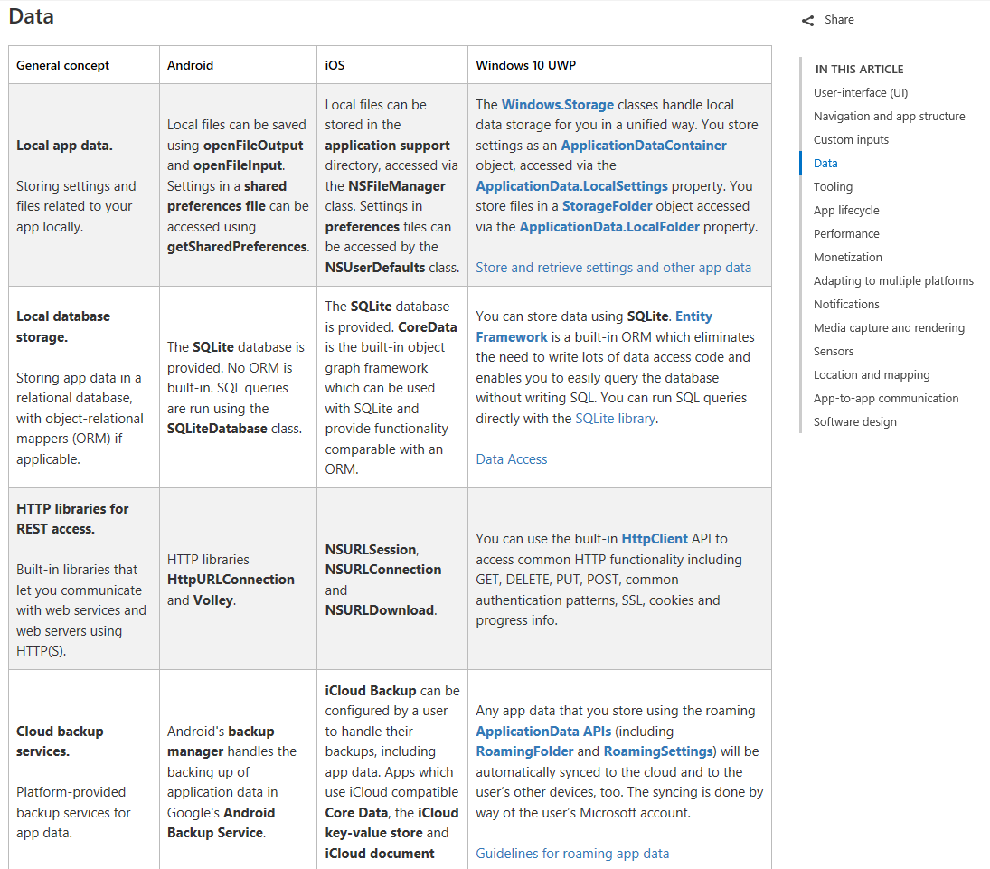
Android and iOS apps
Porting your Android and iOS apps to the Universal Windows Platform on Windows 10
Porting guidance
Concept map to translate between platforms
Broken out into 15 sections
Quickly see the differences
Dive deeper into additional documentation
http://aka.ms/UWPPortingMap
Additional porting resources
What’s a Universal Windows Platform app?
Getting started with UWP for iOS developers
Introduction to UWP design
Porting apps to Windows 10
Porting guidance
Concept map to translate between platforms
Broken out into 15 sections
Quickly see the differences
Dive deeper into additional documentation
http://aka.ms/UWPPortingMap
Additional porting resources
What’s a Universal Windows Platform app?
Getting started with UWP for iOS developers
Introduction to UWP design
Porting apps to Windows 10

Slide 20
iOS apps
Bringing your Objective-C code to the Universal Windows Platform on Windows 10
Windows Bridge for iOS
Enable Objective-C development on Window
Adds functionality to your app
Implements iOS-compatible APIs
Promotes code sharing/reuse, not write-once-run-everywhere
Objective-C is Windows native
Your iOS app becomes a native UWP app
Reach all Windows 10 device families
Includes support for keyboard + mouse
Mix and match code and UI, adding more XAML and C# code/capabilities as you go
.appx
.H
.M
.CPP
Notes:
The Windows Bridge for iOS is a Microsoft open-source project that provides an Objective-C® development environment for Visual Studio and support for iOS APIs. The bridge allows you to create Universal Windows Platform apps that will run on any Windows 10 device.
Key features to remember:
Is that it is an open source project and we accept contributions.
Intel has contributed to the project with the Accelerate.Framework.
It lets iOS Developers reuse their existing Objective-C code.
The end result is a Universal Windows app that can run on Windows.
This helps an iOS Developer expand reach and add their app to the Windows Store.
High-level goals of the project :
Bring your iOS code to Visual Studio, not just sticking it in a box and calling it a UWP app, bad experience for users, limiting for devs
More than that, the iOS bridge makes it easy to extend your app to take advantage of some of the APIs Windows offers like Cortana, Live Tiles and more.
If you wrote an iOS app, you can take advantage of the frameworks Apple provides, such as UIKit, CoreFoundation, CoreGraphics, GLKit
In order for you to reuse all of that code, we’ve implemented parts of those frameworks on Windows, so you can use them alongside Windows APIs
Caveats to this approach, missing APIs, iOS is big, that’s why open source
Open source not just something we do, fundamental tenet of the project and critical to our mission to allow iOS developers…
The Windows Bridge for iOS is an evolving project. It will require developer work for newer iOS releases. As the project matures, iOS API coverage will grow.

Slide 21
iOS apps
Bringing your Objective-C code to the Universal Windows Platform on Windows 10
C:\>_
Copy
Run
Open
Deploy
Your Xcode project to Windows
vsimporter from the Command Prompt
Project in Visual Studio and make changes in Objective-C
To Windows, including mobile and Xbox One
Similar to slide 15, need a process slide that shows:
Copy your Xcode project to Windows
Run vsimporter from the Command Prompt
Open project in Visual Studio and make changes in Objective-C
Deploy to Windows, including Mobile and Xbox One
Notes:
What does it take to get started using the Windows Bridge for iOS?
Simply copy your Xcode project over to a Windows Machine. After you download the latest pre-built SDK from our GitHub repo, you navigate to the directory that your Xcode project is in and run vsimporter from the command line. In this example, you can see that it created a WOCCatalog-WinStore10.sln file and ignore any unsupported types.
After vsimporter has been run, a Visual Studio project has been created. The project can now be opened in Visual Studio 2015 by simply double clicking on the solution file. After you double click on the solution file, the project loads in Visual Studio. This is using the Objective-C language that you are already familiar with.
The final app is now a UWP app running on PCs, phones, Xbox One, etc.

Slide 22
Demo
iOS apps to the Universal Windows Platform with the Windows Bridge for iOS
Notes:
Demo:
You need the WinObjC pre-built SDK for this demo. You can get it here: https://github.com/Microsoft/WinObjC/releases/
In the extracted folder, look for the file ~/bin/obj-syntax-highlighting.vsix. Double-click on this file. It will install additional syntax coloring into VS2015 to make the Objective C code look better.
Open the sample project in VS2015: winobjc/samples/WOCCatalog
Compile and run the sample, showcasing the various elements
In the app, click on "Display Mode", then click around in the first control to show different display layouts. App resolution will change a few times. Go back to Native then hit Back in the upper left corner.
In the app, click on "Controls". Play with the controls while talking then hit Back in the upper left corner.
In the app, click on "Pickers". Show the date and time picker.
In the app, click on "Alerts". Play with a few of the alert examples while talking. Hit Back when done.
In the app, click on each of "Open GLES 1.1", "Open GLES 2.0" and "Open GLKit".
We use ANGLE to redirect Open GL calls to DirectX for excellent performance – for either the preset shaders in OpenGLES 1 or programmable shaders in OpenGLES 2 and GLKIT.
In the app, click on "XAMLControls". The video will play. You can let it go a few moments then press the pause button.
Flip back to Visual Studio. You don't need to stop the app. Go to the Solution Explorer window and click on XamlViewController.m. A new edit window will appear. Click down a few screens to find the line that says:
self.playPauseButton = [WXCButton create];
Here's the code for the page we just saw. You can see that we've added Objective-C projections to UWP objects with the iOS bridge to support the popular Windows UI features. This lets you integrate additional Windows features to your application as you progress.

Slide 23
Bringing your code to Windows 10
Expanding middleware partnerships
Extending your investments on the web
Bridges for Windows and other mobile platforms
Notes:
To recap:
We’re continuously expanding partnerships with top middleware providers to ensure you can continue to use your current ecosystem of tools
With our out-of-the-box support for Apache Cordova in Visual Studio 2015 and mechanisms to create web apps that can natively access Windows features, you can extend your investments on the web to Windows 10
Finally, a number of bridging technologies and porting guidance is being created by Microsoft, partners and the community to accelerate the adoption of the Universal Windows Platform

Slide 24
Additional Resources
https://developer.microsoft.com/windows/
https://developer.microsoft.com/windows/bridges/
</ >
</ >
thank you
thank you
<name>
<email>
<twitter>

